Slide 1
4.1.2. A – Cellular replication: Meiosis
TEXT –
8.1 CELL DIVISION AND REPLICATION

Slide 2
Learning intention Success criteria
Within the process of meiosis I and II
recognise the role of homologous chromosomes
Within the process of meiosis I and II
Identify and recall the role of homologous chromosomes

Slide 3
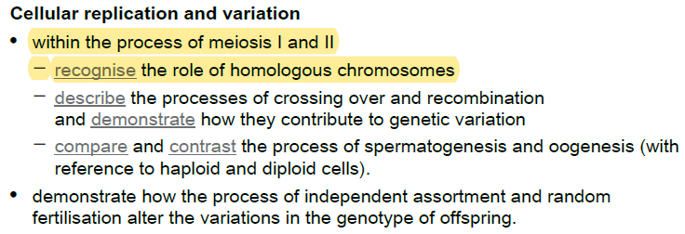

Syllabus check:
By the end of the lesson you should be able to…
NOTE SPECIFICALLY….

Slide 4
Review of Chromosomes
Before we can start learning about meiosis we need to start by reviewing two other concepts, first homologous chromosomes – what they are and how they function - and then the process of mitosis.

Slide 5
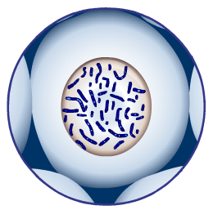

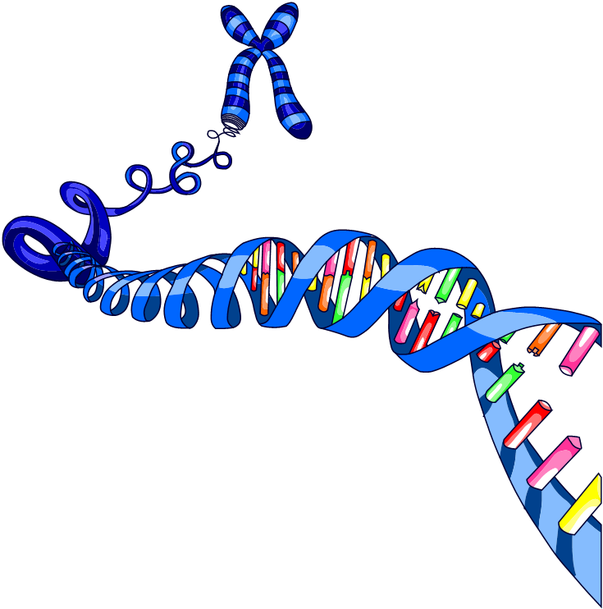
What are chromosomes?
Chromosomes are long strands of genetic information
located in the nuclei of cells.
Chromosomes are most visible
during cell division when they
replicate and look like this…
You will see chromosomes represented both ways.

Slide 6
Homologous chromosomes
In most cells chromosomes are matched in pairs based on their size and shape.
chromosome from female parent
chromosome from male parent
homologous
chromosomes
Matching pairs of chromosomes are called homologous chromosomes.
Each pair of homologous chromosomes contains one chromosome that has been inherited from each parent.

Slide 7
Human chromosomes
In human body cells there are a total of 46 chromosomes.
How many pairs of homologous chromosomes are there in human body cells?
23 pairs of chromosomes
You inherit half your chromosomes from
your mother and half from your father.
How many chromosomes do you inherit from each parent?
23 unpaired chromosomes

Slide 8
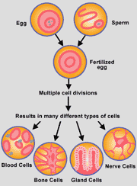
Cell division
All complex organisms originated from a single fertilised egg.
Every cell in your body started here, through cell division the numbers are increased.
Cells then specialise and change into their various roles.

Slide 9
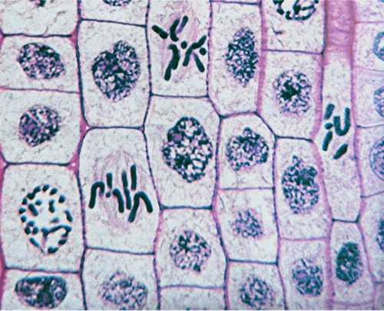
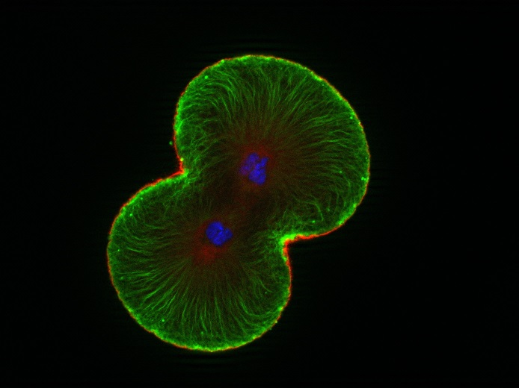
Two forms of cell replication
Mitosis:
-division of somatic (body) cells.
- Used for growth and repair
Meiosis
-division of gametes (sex cells).
-used solely for sexual reproduction

Slide 10
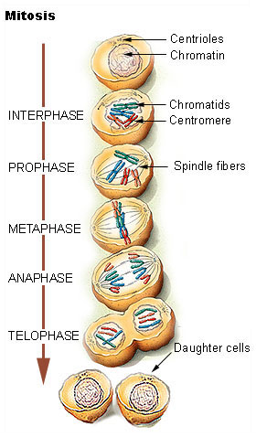
Review of Mitosis
Mitosis occurs in a set of five phases characterised by specific processes or actions. These phases are:
Interphase
Prophase
Metaphase
Anaphase
Telophase

Slide 11
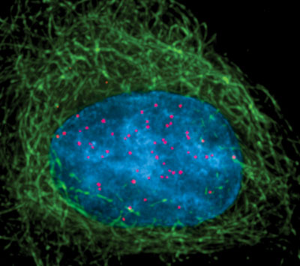
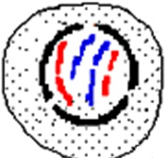
Interphase
Cells spend most of their time in this phase.
Completes ordinary cell functions.
Genetic material doubles (replicated).

Slide 12
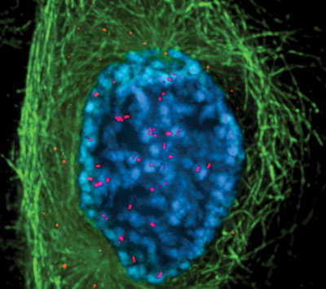
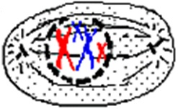
Prophase
Chromosomes pair up!
Chromosomes thicken and shorten.
• become visible.
• 2 chromatids joined by a centromere.
Centrioles move to the opposite sides of the nucleus.
Nuclear membrane disintegrates.

Slide 13
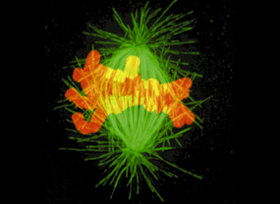
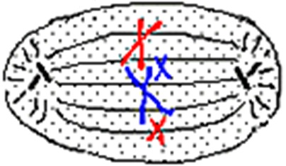
Metaphase
Chromosomes meet in the middle!
Chromosomes arrange at equator of cell
Become attached to spindle fibres by centromeres
Homologous chromosomes do not associate

Slide 14
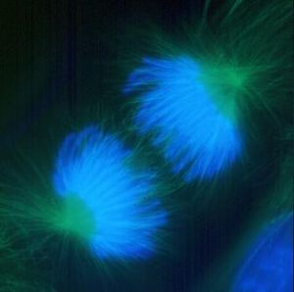
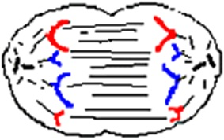
Anaphase
Chromosomes get pulled apart!
Spindle fibres contract pulling chromatids to the opposite poles of the cell

Slide 15
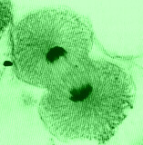
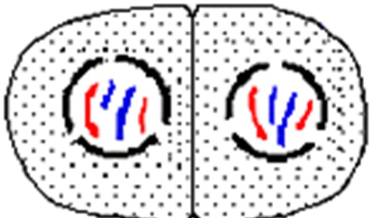
Telophase
Now there are two!
Chromosomes uncoil
Spindle fibres disintegrate
Centrioles replicate
Nuclear membrane forms
Cell divides

Slide 16
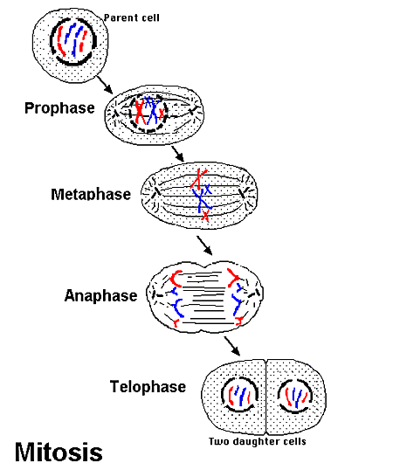

Slide 17
Mitosis
All daughter cells contain the same genetic information from the original parent cell from which it was copied. These cells are diploid (2n), meaning they have the complete complement of 46 chromosomes in humans. They therefore carry all the potential variations of each gene you received from the parental gametes
Every different type of cell in your body contains the same genes, but only some act to make the cells specialise – e.g. into nerve or muscle tissue.

Slide 18
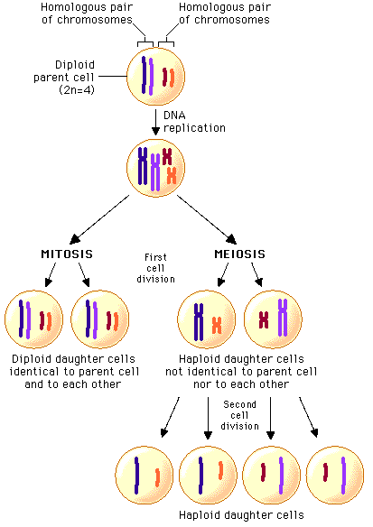
Meiosis
2 sets of cell division involved.
4 daughter cells produced.
Each daughter cell has half the chromosomes of the parent, with one of each pair of homologous chromosomes in each.
This halving of chromosomes produces a cell that is described as being haploid (half the total number of chromosomes) and is represent as ‘n’. This is in contrast to 2n in somatic, diploid cells with the full complement of 46 chromosomes

Slide 19
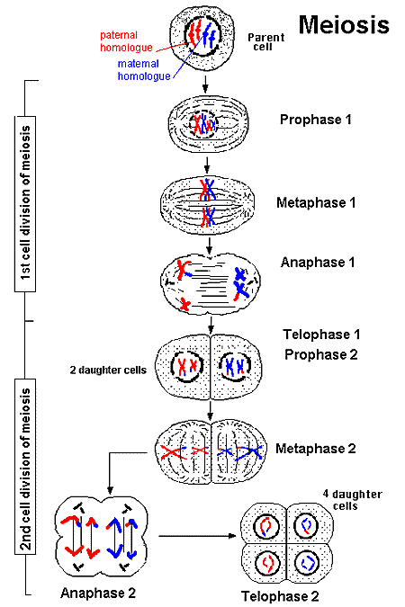
Stages of Meiosis: Role of Homologous Chromosomes
Note the orientation of homologous chromosomes side by side in ‘Metaphase 1’ (rather then above each other as seen in Mitosis). This a
1. The role of homologous chromosomes in meiosis one is to provide opportunity for crossing over (swapping of sections of chromosome) and independent assortment, and therefore recombination of genes, increasing diversity. The homologous chromosomes then separate in Anaphase 1.
2. The role of these homologous chromosomes in meiosis two is the separation of sister chromotids. This means that by prophase 2 each daughter cell (gametese) is haploid and has only 23 chromosomes.
Draw the given diagram

Slide 20
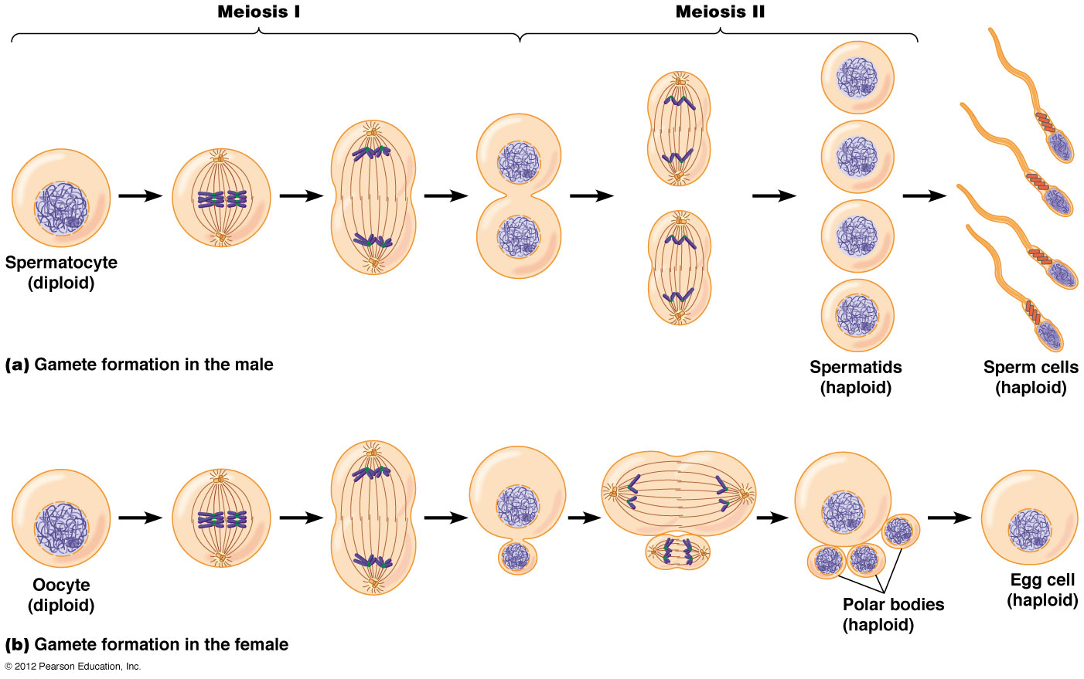
Stages of Meiosis

Slide 21
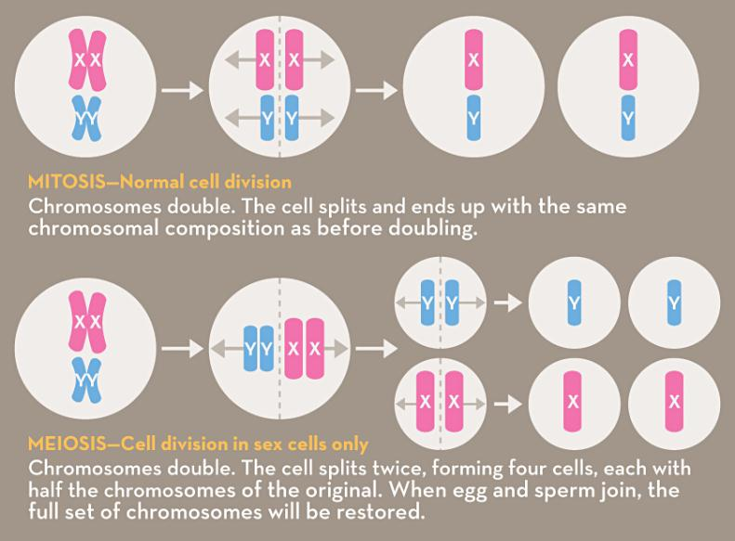
Review: Mitosis/Meiosis

Slide 22
Meiosis
Egg cell and sperm cell combine to form zygote (new organism)
½ chromosomes in egg + ½ chromosome in sperm
= NEW ORGANISM WITH RIGHT NUMBER OF CHROMOSOMES
(Females and males contribute 23 chromosomes for a total of 46, this is possible thanks to meiosis, since cells naturally have 46 chromosomes.)
video

Slide 23
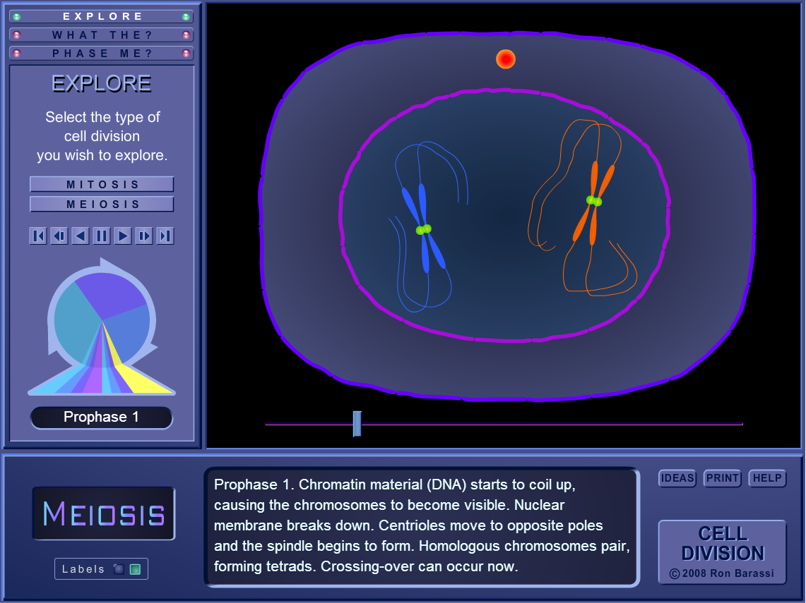
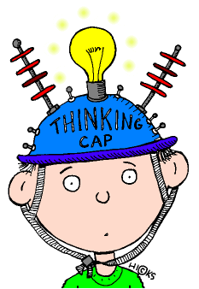
For those with laptops…
Try this interactive activity.
You may need this PIN: LGHPOH
http://www.scootle.edu.au/ec/pin/LGHPOH?userid=130070

Slide 24
Exit ticket: a. Within the process of meiosis I and II - recognise the role of homologous chromosomes PA MOCKEXAM 2020 MC
QUESTION 13
During meiosis II, what is the role of homologous chromosomes?
Pairing
Separation
duplication
recombination

Slide 25
Give Me More:
Further research;
1. Mitosis.
“ Mitosis: Splitting Up is Complicated - Crash Course Biology #12 ” (Crash Course)
https://youtu.be/L0k-enzoeOM
2. Meiosis.
“ Meiosis: Where the Sex Starts - Crash Course Biology #13 ” (Crash Course)
https://youtu.be/qCLmR9-YY7o
2. Mitosis and Meiosis.
“ Comparing mitosis and meiosis | Cells | MCAT | Khan Academy ” ( Khan Academy )
https://youtu.be/qCLmR9-YY7o

